Slide 1
Generative Adversarial Networks
Rubens Zimbres
Data Scientist
Machine Learning for IoT at Vecto Mobile

Slide 2
Generative Models
Discriminative Models
Game Theory
Prisoner’s Dillemma
Nash Equilibrium
Rational choice
Bounded Rationality
Non cooperative Game
Training GANs
Some examples

Slide 3
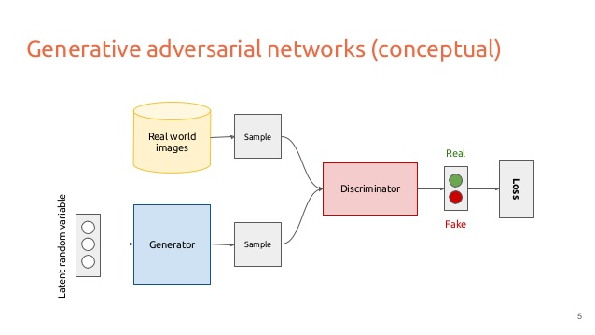
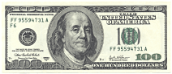
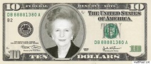


Player 1 (D)
+ Noise
Player 2 (G)

Slide 4
Generative Models
Probabilistic, samples from joint distribution P(x,y)
Generate samples (latent variables) following a distribution
Maximum Likelihood
Range of values belong to a class

Slide 5
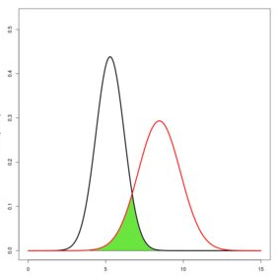
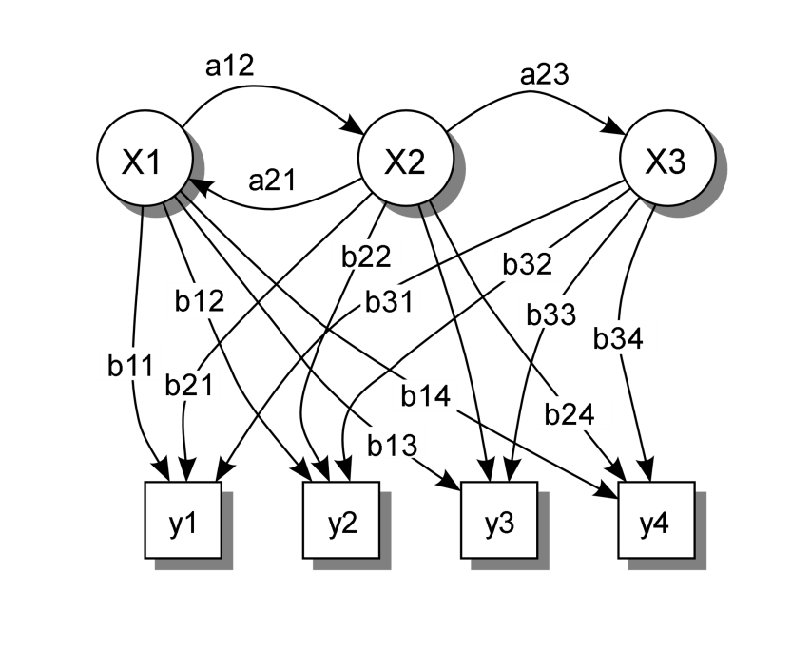
Generative Models
Latent Dirichlet Allocation (NLP)
Naïve Bayes
Mixture Gaussians
Hidden Markov Model
VAE
RBM
GANs

Slide 6
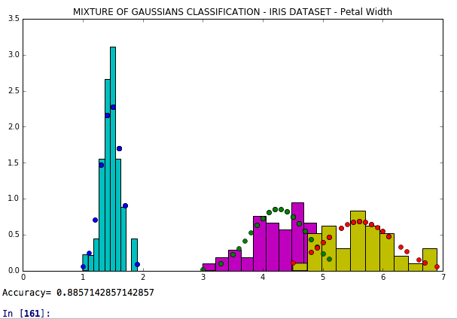
Mixture of Gaussians
X
X

Slide 7
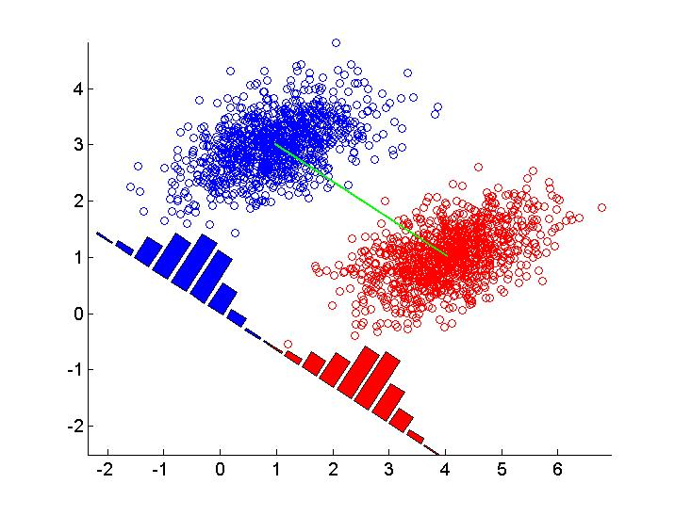
Linear Discriminant Analysis
X

Slide 8
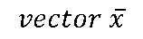
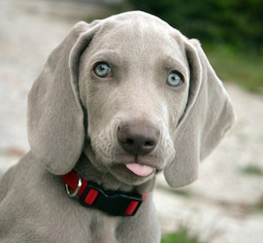
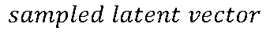
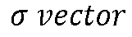
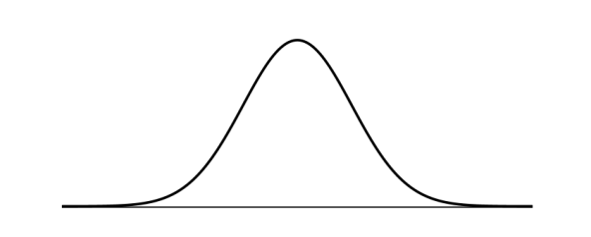
Variational Autoencoders
Backprop
Kullback–Leibler divergence KL (surprise)
Encoder
Decoder
Blurred

Slide 9
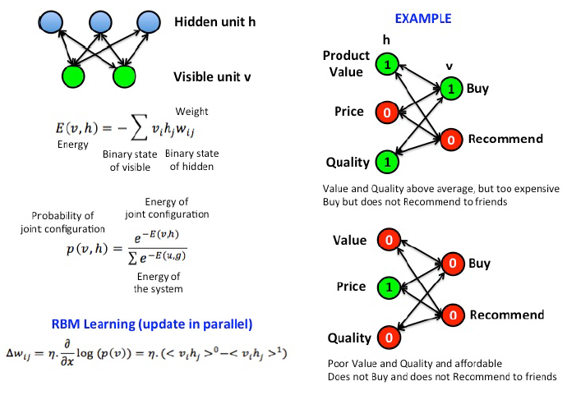
Restricted Boltzmann Machines

Slide 10
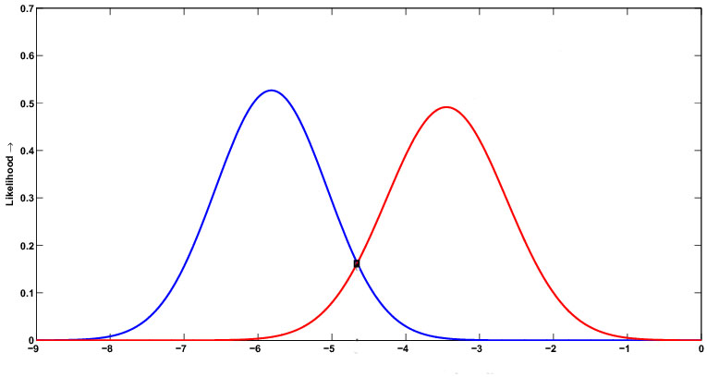
Generative Models
Y₁
Y₂
Buy
Recommend
X₁
X₂

Slide 11
Discriminative Models
Observed variables: target, infer outputs, conditional
Function maps from x to Y
Conditional density function
P(Y|x) subsample
Decision bounday
Computationally expensive

Slide 12
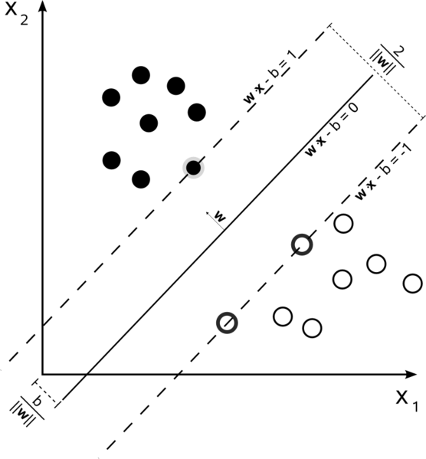
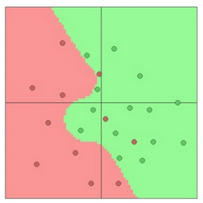
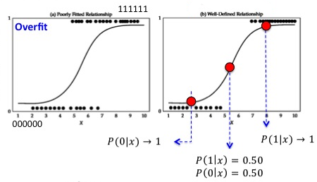
Discriminative Models
Logistic Regression
SVMs
Neural Networks

Slide 13
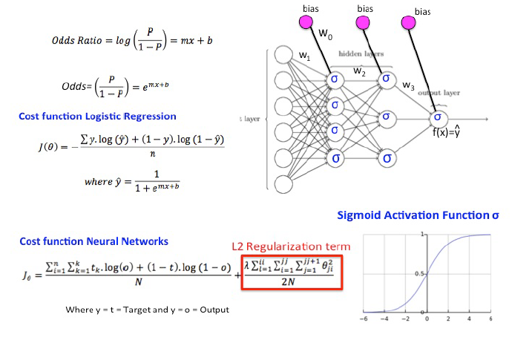

Slide 14
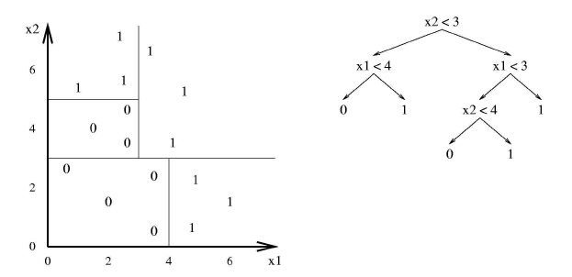
Decision Trees

Slide 15
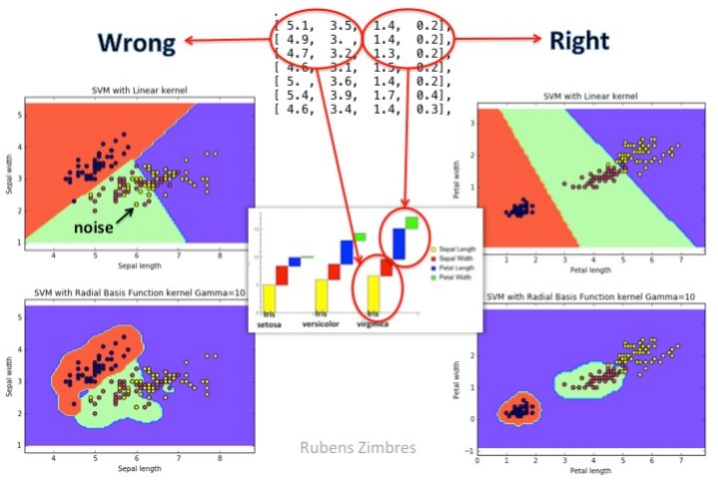
Occam’s razor Principle

Slide 16
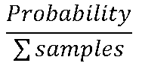
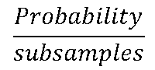
Generative vs Discriminative
Generative learns joint probability distribution = P(x,y)
Discriminative learns conditional probability distribution = P(y|x)

Slide 17
GAN Advantages over Generative Models
D & G = Multi Layer Perceptron
Regular backpropagation like VAE (G and D differentiable)
Does not necessarily involve Maximum Likelihood estimation
No need to use Markov Chains
Subject but robust to overfitting

Slide 18
Game Theory
2 Player Game – Zero Sum
Minimax solution: Nash Equilibrium
Unique solution: D=1/2 everywhere

Slide 19
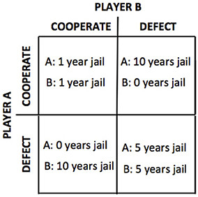
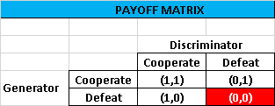

Slide 20
Nash Equilibrium
Sub optimal
Non cooperative
Emulate human behavior: bounded rationality (Herbert Simon)
Simultaneous but not equivalent ** (GANs)

Slide 21
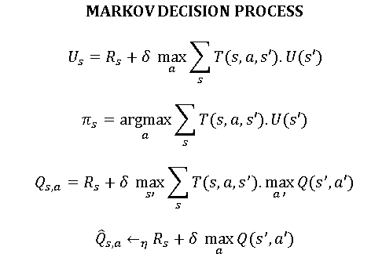
GANs
Semi Supervised Learning: missing labels
Inverse Reinforcement Learning

Slide 22
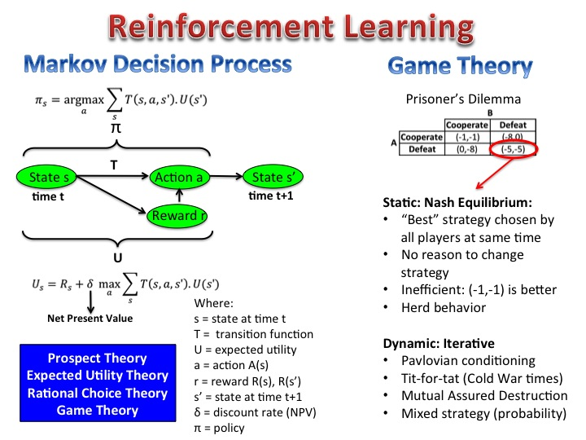

Slide 23
GAN
Denoising Autoencoder
Latent Variables
(add noise)
Fake
Latent Variables
(add noise)
MLP
MLP
G
Encoder
Training Data
Real
COOPERATIVE
(1,1)
ADVERSARIAL
(0,0)
MLP
MLP
D
Decoder
1
Real MNIST

Slide 24

Question
How can we change GAN’s strategy to create e WIN-WIN situation with payoff equal to (1,1) ?

Slide 25
Siamese GAN
Latent Variables
Add (noise)
Fake
Training Data
Real
MLP
MLP
G
G
Infiltrated Cop
Training Data
Real
ADVERSARIAL
(0,0)
COOPERATIVE
(1,1)
MLP
D
1

Slide 26
GAN Tuning
Neural Network architecture
Hyperparameters
Game Theory strategies

Slide 27
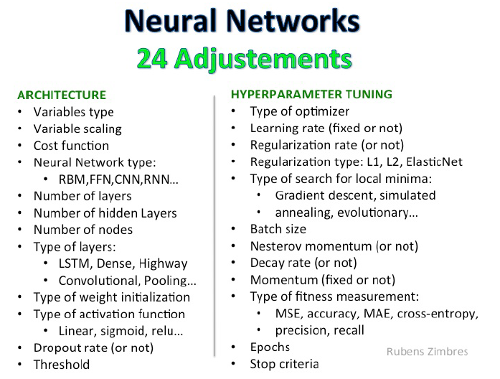

Slide 28
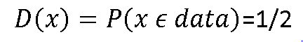
GANs
Train Simultaneously (no freeze)
Train Discriminator one step
Train Generator k steps (no Nash)
Until p_{G}=p_{data} (global optimum)
Discriminator cannot distinguish both distributions

Slide 29
GANs
x comes from p_{data} y=1 (Real)
x comes from p_{G} y=0 (Fake)
Optimize θ rather than p_{G}
G: Relu (vanishing gradient)
Dropout
Supervised Learning in D:
Beginning: high confidence
Usually D is bigger/deeper than G

Slide 30
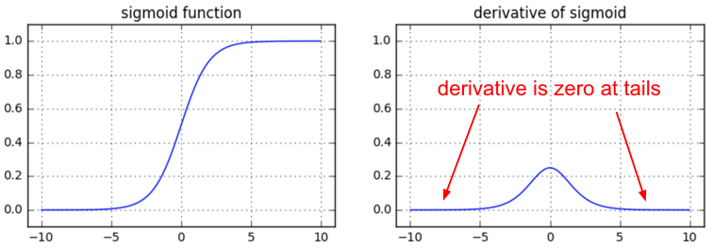
Vanishing Gradient
-25% each activation
Image source: Andrej Karpathy

Slide 31
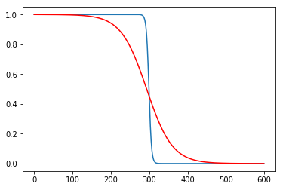
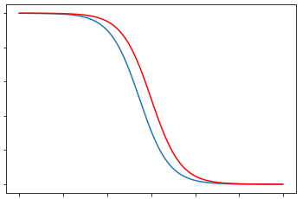
Coefficient and Intercept: Regularization

Slide 32
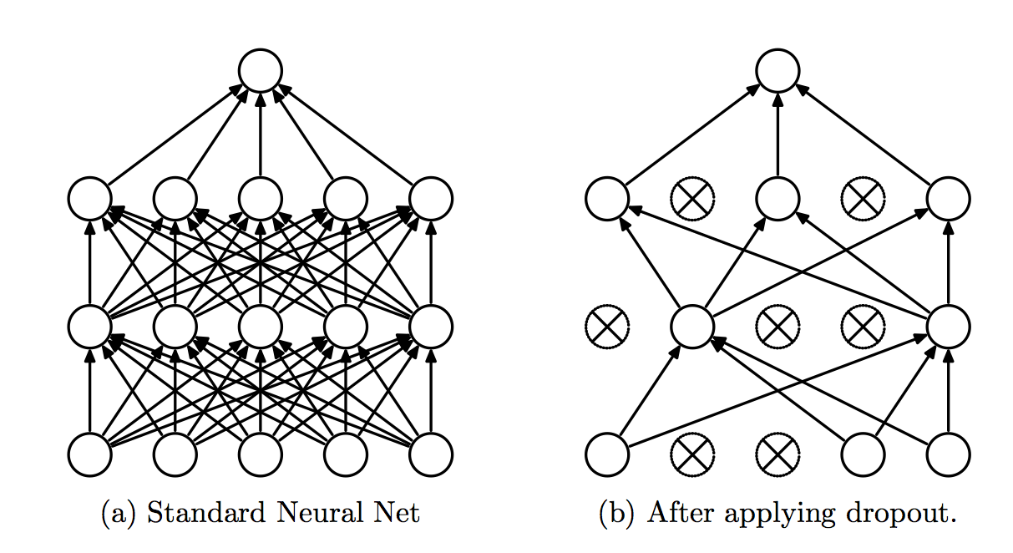
Dropout

Slide 33
Training GANs
Generator: Gradient Descent on V
Discriminator: Gradient Ascent on V
Minibatch
Batch Normalization in G ***
To minimize Cross Entropy
Minimax Game
Regular cross entropy

Slide 34
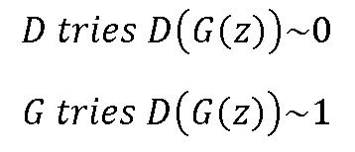
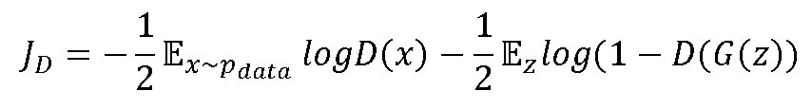
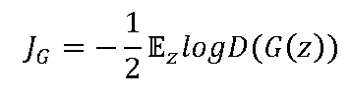
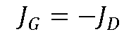
Training GANs
Discriminator minimize J^{(D)}(θ^{D}, θ^{G}) controlling θ^{D}
Generator minimize J^{(G)}(θ^{D}, θ^{G}) controlling θ^{G}
Cannot control each other
(G still learns)

Slide 35
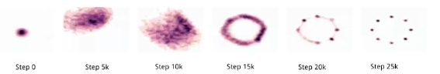
Training Challenges
Non convergence: Nash Equilibrium, harder to optimize than objective function
Mode collapse: G fails to output diversity (few good samples)
D converges to right distribution
G generates samples in the most probable point
Solution: k steps for D training for 1 step G training

Slide 36
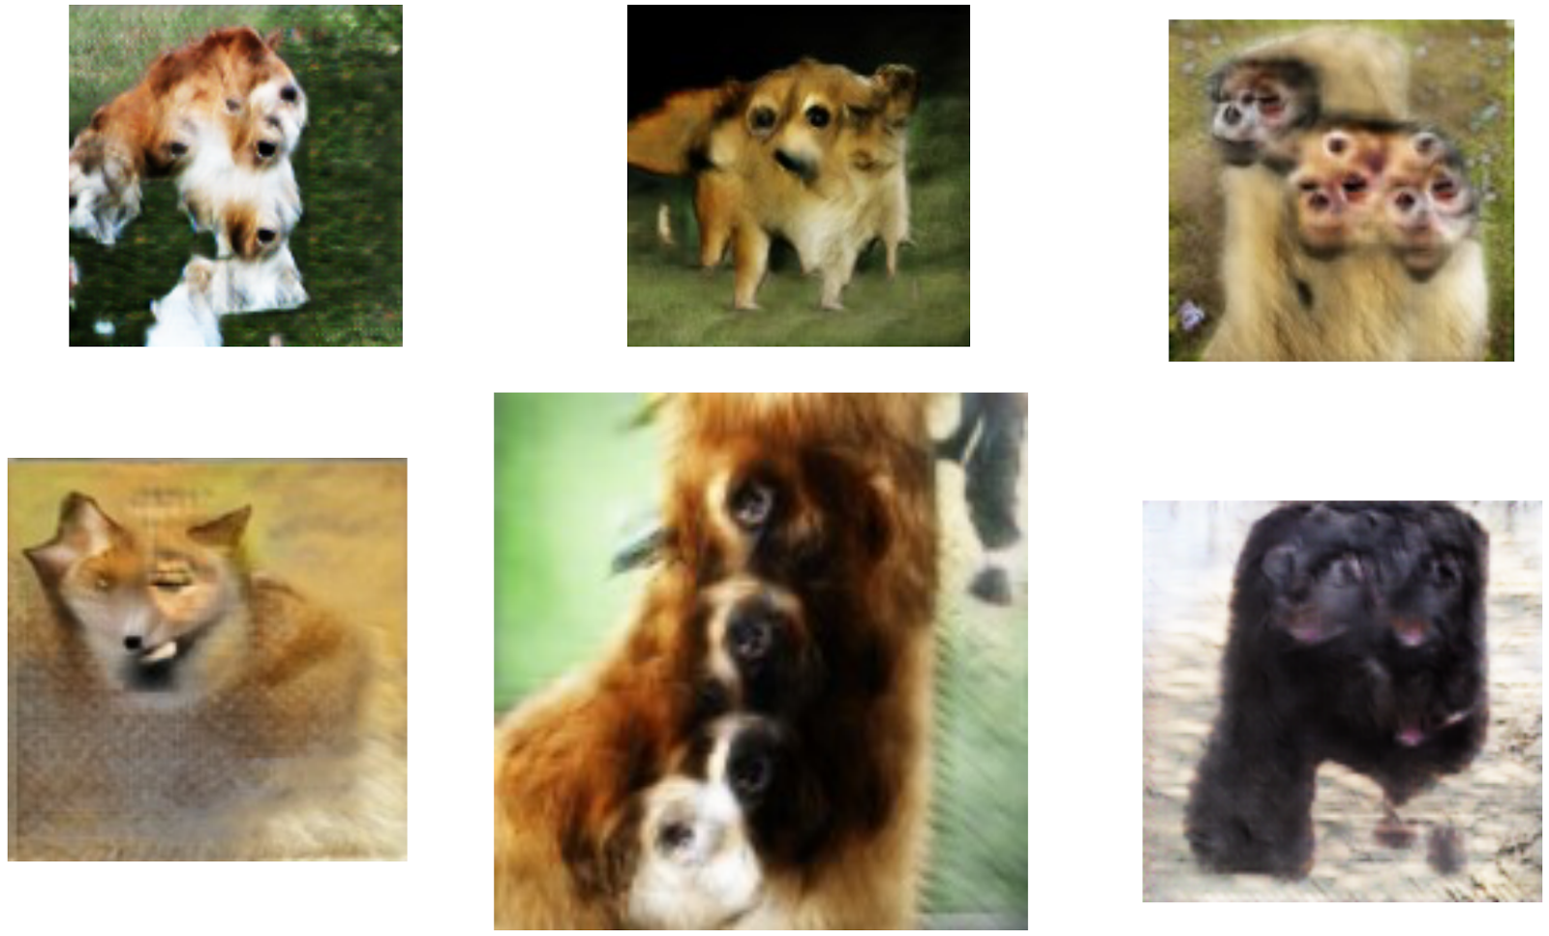
Training Challenges

Slide 37
Tips and Tricks for GANs
Normalize data (-1,1)
Activation function Tanh output of Generative
Sample from gaussian distribution instead of uniform distribution
Develop diferente mini-batches in Discriminator:
All real
All fake
Use Batch Normalization

Slide 38
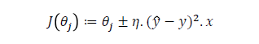
Tips and Tricks for GANs
Use DCGANs or VAE+GAN
Adam in Generator (exp. momentum decay)
(Adaptive Moment Estimation)
SGD in Discriminator
If Generator loss high = garbage to Discriminator
Dropouts in Generator (overfitting)

Slide 39
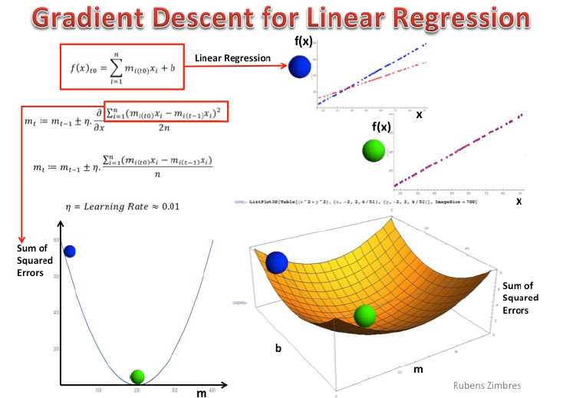

Slide 40
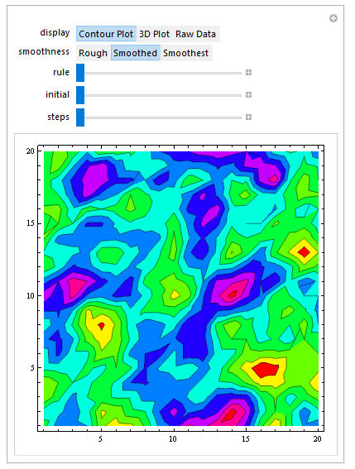
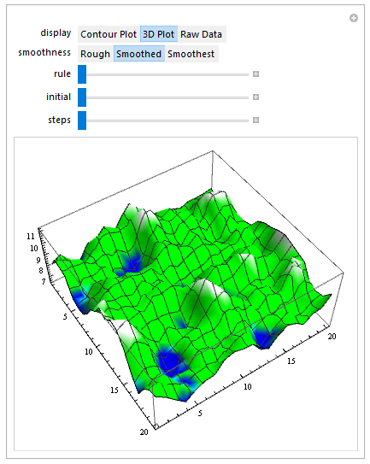

Slide 41
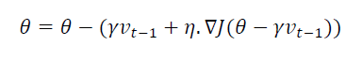
Gradient Descent
Nesterov Momentum

Slide 42
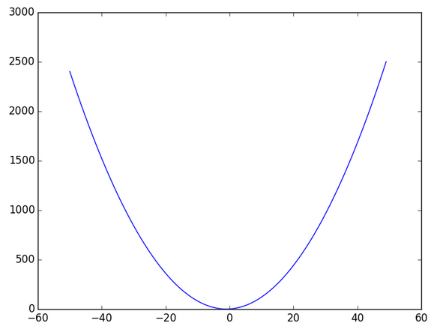
Adam Optimizer
Momentum w/ exponential decay according to derivative of error

Slide 43
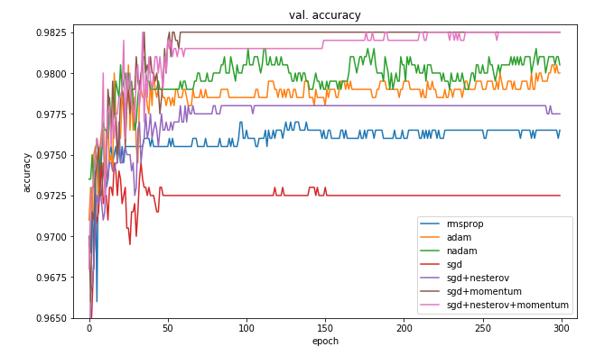
Optimizers: generalization
Wilson et al, 2017

Slide 44
GAN Examples: Vector Arithmetic

Slide 45
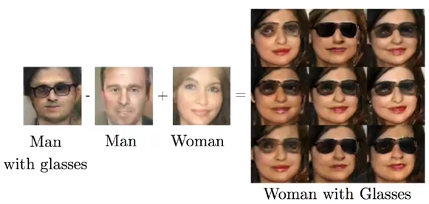
Vector Arithmetic
Radford et al, 2015

Slide 46
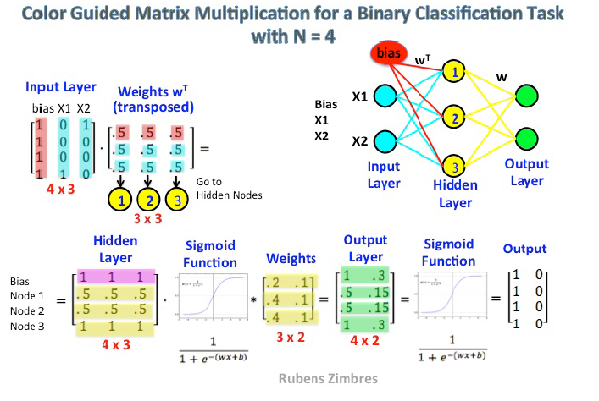
Matrix Multiplication

Slide 47
DCGAN
Deep Convolutional GAN
Batch Norm not in end of Generator and NOT in Discriminator (x covariate shift)
To increase dimension, Upsampling: convo2D.T with stride > 1
Downsampling: average pooling + conv2D + stride

Slide 48

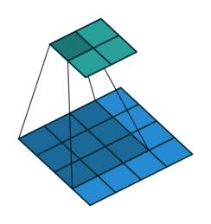


Convolutions
Convolution2D Convo2DTranspose
3x3 kernel 4x4 input stride=1 3x3 kernel 2x2 input stride=1

Slide 49
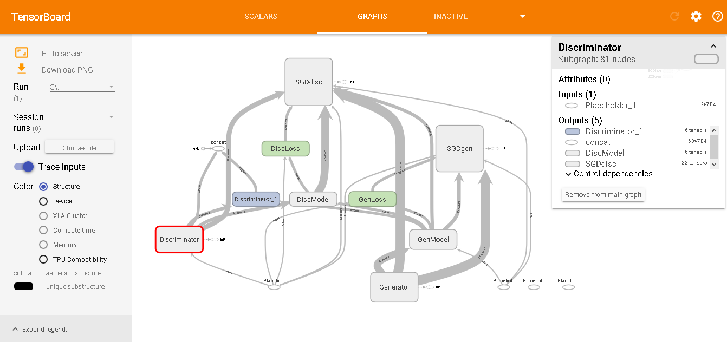
DCGAN Architecture

Slide 50
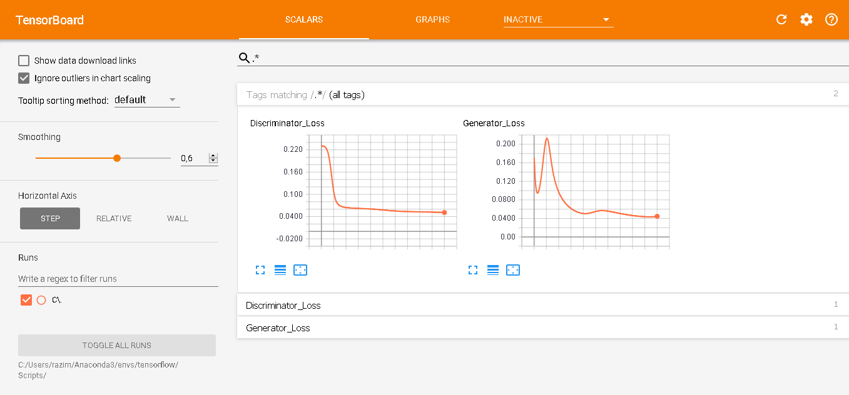
DCGAN Training

Slide 51

DCGAN Output

Slide 52

DCGAN Output

Slide 53

DCGAN – Face Recognition

Slide 54



Info GAN
Based in Mutual Information and Entropy (uncertainty)
Coin toss

Slide 55
Latent Variables
(add noise)
Fake
b
b=[1,1,1,1,1,1,1,1,1,1] N=10
MLP
G
H(B)=-SumP(B=b).logP(B=b)
B=[0,0,0,0,0,1,1,1,1,1]
P(B=b) = 0.5
Relu
Training Data
Real
B
H(B)=-0.5.log(0.5)
H(B)=-0.15
MLP
B=[0,0,0,0,0,1,1,1,1,1]
A=[0,0,0,0,0,0,1,1,1,1]
P(A|B=b) = 4/5= 0.8 (subsample)
D
H(A|B=b)=-0.8.log(0.8)
H(A|B=b)=-0.04
A

Slide 56

Info GAN Output

Slide 57


Info GAN Output

Slide 58

Info GAN Output

Slide 59


cGAN: Conditional GANs

Slide 60


GAN Examples
Next frame prediction
Image-to-image translation
Lotter et al, 2016
Isola et al, 2016

Slide 61


GAN Examples
Text-to-Image generation Image Inpainting
Reed et al, 2016
Pathak et al, 2016

Slide 62





Cycle GAN: Style Transfer
Zhu et al, 2017

Slide 63


Slide 64


Slide 65


Slide 66
Different Game Strategies
“Rather than” tuning architecture and hyperparameters
Freeze layers (unofficial implementation)
Discriminator : Generator
1:1
5:1
1:5
Cooperation
Random strategy update
Tit-for-Tat strategy

Slide 67
Architecture: Denoising Autoencoders
Backprop
Convolution 2D
MaxPooling
Convolution 2D
MaxPooling
Convolution 2D
UpSampling
Convolution 2D
UpSampling

Slide 68

Gan Structure

Slide 69


One Pixel Attack to Fool Neural Nets

Slide 70


Slide 71


Generated Samples
$$noise=x+0.1∗rnd\left(0,1\right) \overline{x}=0 σ=1$$

Slide 72


Update strategy
Synchronous Asynchronous
http://www.nytimes.com/interactive/science/rock-paper-scissors.html

Slide 73

1:1 Update (Vanilla GAN)
Latent Variables
(add noise)
Fake
MLP
G
Train Simultaneously
Accuracy Training Set: .92
Accuracy Test Set: .914
Nash Equilibrium: Sub-optimal
Training Data
Real
MLP
D
Learning Rate: 0.008
Epochs: 1,000 each
Generator optmiz: Adam
Discriminator optimiz: SGD
Decay Rate: 5e-5
Momentum: 0.9
Train Simultaneously
1

Slide 74

5:1 Update
Latent Variables
(add noise)
Fake
MLP
G
Train 1 time
Accuracy Training Set: .91
Accuracy Test Set: .91
Training Data
Real
MLP
D
Learning Rate: 0.008
Epochs: 1,000 each
Generator optmiz: Adam
Discriminator optimiz: SGD
Decay Rate: 5e-5
Momentum: 0.9
Train 5 times
1

Slide 75

1:5 Update
Latent Variables
(add noise)
Fake
MLP
G
Train 5 times
Training Data
Real
Accuracy Training Set: .92
Accuracy Test Set: .91
MLP
D
Learning Rate: 0.008
Epochs: 1,000 each
Generator optmiz: Adam
Discriminator optimiz: SGD
Decay Rate: 5e-5
Momentum: 0.9
Train 1 time
1

Slide 76

Cooperation
Latent Variables
(add noise)
Fake
Training Data
Real
MLP
G
Train at once
x sigmoid
Vanishing gradient
Accuracy Training Set: .99
Accuracy Test Set: .93
MLP
D
Learning Rate: 0.008
Epochs: 1,000 each
Generator optmiz: Adam
Discriminator optimiz: SGD
Decay Rate: 5e-5
Momentum: 0.9
Train at once
1

Slide 77



Random Strategy
Latent Variables
(add noise)
Fake
MLP
G
Train at chance
x sigmoid
Vanishing gradient
Accuracy Test Set: .98
Accuracy Test Set: .96
Polarization of Game until
Relu
Training Data
Real
$$N=∞$$
MLP
$$\overline{x}≈0.5$$
D
Learning Rate: 0.008
Epochs: 1,500
Generator optmiz: Adam
Discriminator optimiz: SGD
Decay Rate: 5e-5
Momentum: 0.9
Train at chance
1

Slide 78



Tit-For-Tat Strategy
Latent Variables
(add noise)
Fake
MLP
G
Train with penalty
if provides noisy
samples
$$noise=x+0.1∗rnd\left(0,1\right) \overline{x}=0 σ=1$$
Accuracy Test Set: .96
Accuracy Test Set: .92
Training Data
Real
$$noise=x+0.4∗rnd\left(0,1\right) \overline{x}=0 σ=1$$
Accuracy Test Set: .92
Accuracy Test Set: .91
MLP
D
Train
Learning Rate: 0.008
Epochs: 1,500
Generator optmiz: Adam
Discriminator optimiz: SGD
Decay Rate: 5e-5
Momentum: 0.9
% noisy samples
In GAN training:
1

Slide 79
Freeze Layers
Latent Variables
(add noise)
Fake
MLP
G
Train Second
x sigmoid
Vanishing gradient
Relu
Accuracy Training Set: .63
Accuracy Test Set: .12
Training Data
Real
MLP
D
Train First
Freeze weights
Learning Rate: 0.008
Epochs: 1,000 each
Generator optmiz: Adam
Discriminator optimiz: SGD
Decay Rate: 5e-5
Momentum: 0.9
* SYNCHRONICITY
1

Slide 80

Experiment Results

